Slide 1
Predicting Transcription factor-DNA Binding from Sequence
Xuan Liu/Fred Kehang Chang

Slide 2
Project Goals
Let seq denote the approx. 500 base pair DNA sequences. Let PWMs denote known binding sites for a given TF. Let Y denote experimentally determined ChIP scores for a given TF, and Y are used as labels for training and testing.
The goal is to train a model (binary classifier) to predict if a given seq will bind to a given TF providing known PWMs, and Y as a true label.
F_{𝜭}(seq, PWMs) TF-DNA binding score*
*(0 or 1 based on the predefined threshold of the ChIP score)
For 𝜭 are trainable parameters.
Notes:
exact: 501 base pair

Slide 3
Literature Review
DeepSEA: Motif feature extraction using matrix multiplication
Anchor (Trans-cell type prediction of transcription factor binding sites):
Motif finding for DNase-seq features against background nucleotide distribution

Slide 4
Methods
convert ChIP score to binary label, remove seqs containing N
rescale, normalize, padding motif pwms
scan one-hot encoded input seq with modified pwms for a given TF & scan input seq with an equal-length pwm of background freq of nucleotides
calculate the ratio between the scanning from pwms of a given TF & the scanning from a pwm of background frequency of nucleotides
max-pooling results from multiple pwms
flattening results from multiple pwms
SVM Classifier
binary label
Notes:
seqs containing N can be either ignored or encoded
functions implemented left: cross_validation

Slide 5
Data Preprocessing
Binary Label Conversion
Based on the plotting of ChIP-score distribution for several TFs,
median is selected as the threshold (above threshold:1)
Label Cleaning
Input seqs containing N out (A,C,G,T) are being removed from the data set
One-hot encoding
Input seqs are being encoded with one-hot encoding to enable matrix multiplication

Slide 6
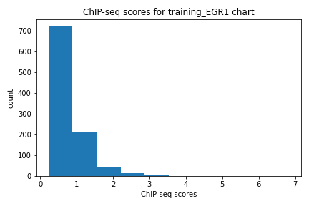
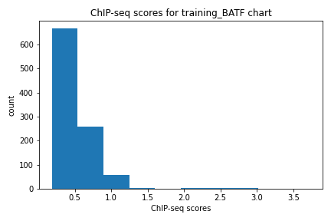
Plots of ChIP-score distribution for several TFs
Plot on the left shows the ChIP-seq score for the training data of EGR1; plot on the right shows the ChIP-seq score for the training data of BATF. The median of the left TF EGR1 is 0.5; the median of the right TF BATF is 0.386426.

Slide 7
PWM Conversion & Padding
PWMs for a given TF are iterated to find the max length
Nucleotides probability in each row is being normalized, and rescaled to a value in [0,100] (sum of values in each row is equal to 100)
Shorter matrix is being padded for tail and head with length of (max length - matrix length)/2, and padded with value [25,25,25,25]
Background matrix is calculated based on nucleotide distribution of given seq; alternative is using [25,25,25,25] for equal distribution
25,25,25,25
padding with length: (max length - matrix length)/2
shorter matrix
25,25,25,25

Slide 8
Pr(seq|PWM) & Pr(seq|Background)
scanning with TF motif PWMs & background PWMs
A
C
G T
1 0
0 0
0 0
0 1
24
25
27
26
SUM(W_{(4,matrix_len)}* X_{(4,i)} )
for i from 0 to (seq_len + 1 - matrix_len)
Ratio = Pr(seq|PWM) / Pr(seq|Background)
= 1-d vector with length of (seq_len + 1 - matrix_len) Based on TF motif PWM
/1-d vector with length of (seq_len + 1 - matrix_len) Based on background PWM
scan with a stride of 1
one-hot encoded seq
Normalized and rescaled pwm matrix of either TF motif or background freq
1-d vector with length of (seq_len + 1 - matrix_len)

Slide 9
Pooling & Flattening
Flatten vs Max-Pooling
max-pooling vertically
V1
X_train = Max (v1, v2, v3, v4, …, vn)
Max-pooling vertically to form a 1-d vector (1,(seq_len + 1 - matrix_len))
or
X_train = Flatten (v1, v2, v3, v4, …, vn)
Concatenate Horizontally to form a 1-d
Vector (1,(seq_len + 1 - matrix_len)*n)
n = # of TF PWMs used
V2
V3
.
.
.
Vn
1-d (Pr(seq|PWM) / Pr(seq|Background)) ratio vector with length of (seq_len + 1 - matrix_len)
stacked together

Slide 10
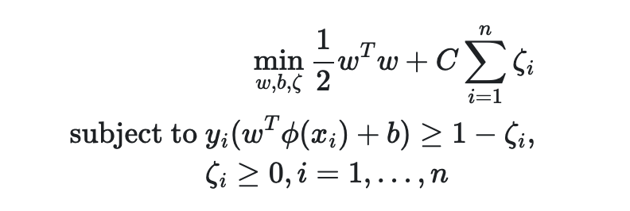
SVM
SVM classifier is being used to predict binary labels
X_{i} for i = 1,...,n as features; y_{i} for i =1 ,..n as labels.
Hyperparameter: C controls the strength of the penalty of misclassification.

Slide 11
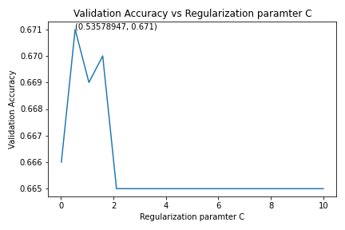
Cross Validation & Hyperparameter Tuning
Tuning Regularization parameter C
The plot shows the cross validation accuracy for TF BATF vs hyperparameter C for SVM classifier. On the x-axis,
regularization term C is being swept from 0.01 to 10, and y-axis shows the corresponding validation accuracy. This plot shows the tuning process of regularization parameter C for TF BATF. It shows that 0.5 is good choice for regularization parameter C.

Slide 12
Train Accuracy vs Test Accuracy across all TFs
This graph below shows the training accuracy vs testing accuracy for every TF. There are 26 TFs in total. The x-axis of the graph represents the training accuracy; the y-axis represents the testing accuracy. A linear line y=x is drawn as the reference.
The graph shows that there is not an overfit or underfit for most of the TFs, since testing accuracy is close to training accuracy for most of the TFs.
(All datasets used max-pooling)

Slide 13
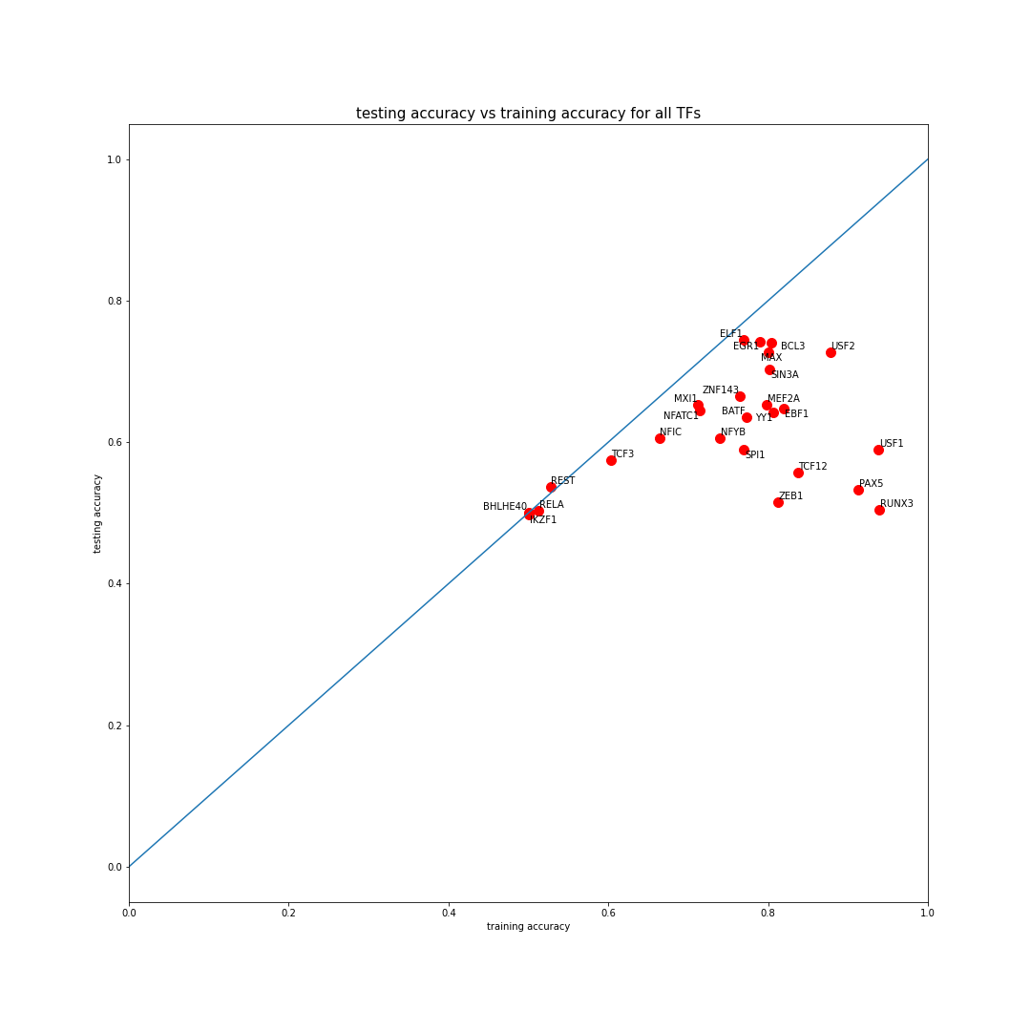

Slide 14
Performance Comparison
The SVM method with a single PWM for a given TF is used as a baseline model for a given TF. The performance of the baseline model is being compared against with SVM method with all provided PWMs for a given TF.
Deep-learning model with PWMs-aided motif extraction is implemented for each TF. The deep learning model reaches comparable results with the SVM method.

Slide 15
SVM method with a single PWM for a TF (Baseline Model Testing Accuracy) vs all PWMs given for a TF
These comparison is displayed as in tabular form for all TFs below. The leftmost column of the table represents the TF name; the second leftmost column represents the average testing accuracy of using one PWM for a given TF (Baseline Model Testing Accuracy). The rightmost column represents the testing accuracy of using all PWMs provided for a given TF. For most of the TFs, the table clearly shows that SVM method that incorporates all PWMs for a given TF performs better than baseline model which only incorporates one PWM for a given TF. (All datasets used max-pooling)
Notes:
Pwms: average:1,2 | first_index0: rest //3:flexible test_acc_all_pwm/single_pwm //4:flexible(testing/train acc.)|test_acc_all_pwm //8:flexible test_acc_single_pwm //12::flexible test_acc_all_pwm//17:flexible test_acc//20: flexible test_acc//21: flexible test_acc //

Slide 16
BATF | 0.575 | 0.635
BCL3 | 0.72 | 0.74
BHLHE40 | 0.49 | 0.5
EBF1 | 0.6025 | 0.6475
EGR1 | 0.62 | 0.7425
ELF1 | 0.6575 | 0.745
IKZF1 | 0.4975 | 0.50
MAX | 0.7 | 0.7275
MEF2A | 0.6025 | 0.6525
MXI1 | 0.64 | 0.6525
NFATC1 | 0.555 | 0.645

Slide 17
NFIC | 0.649 | 0.606
NFYB | 0.565 | 0.605
PAX5 | 0.5 | 0.5325
RELA | 0.5 | 0.5025
REST | 0.5225 | 0.5375
RUNX3 | 0.6 | 0.6
SIN3A | 0.69 | 0.7025
SPI1 | 0.56 | 0.59
TCF12 | 0.61 | 0.61
TCF3 | 0.6 | 0.6
USF1 | 0.5 | 0.59

Slide 18
USF2 | 0.4925 | 0.7275
YY1 | 0.5475 | 0.6425
ZEB1 | 0.47 | 0.515
ZNF143 | 0.53 | 0.665

Slide 19
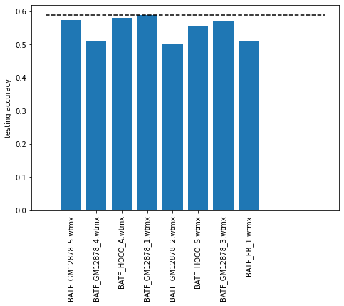
Significant PWMs
By iteratively computing testing accuracy using one given PWM a time, the most significant PWM to predict TF-DNA binding can be selected. This finding might provide some insights to experimentalists.
This bar graph is shown as an example to show that this SVM method can be used to select the most significant PWMs for a given TF.
The bar graph on the left shows the testing accuracy of SVM method for TF BATF by using each PWMs given. On the x-axis, it shows the wtmx used in each model, and on the y-axis, it shows the corresponding testing accuracy. Based on the results, BATF_GM12878_1.wtmx is the most significant PWM for TF BATF.

Slide 20
Deep-learning model with PWMs-aided motif extraction

Slide 21
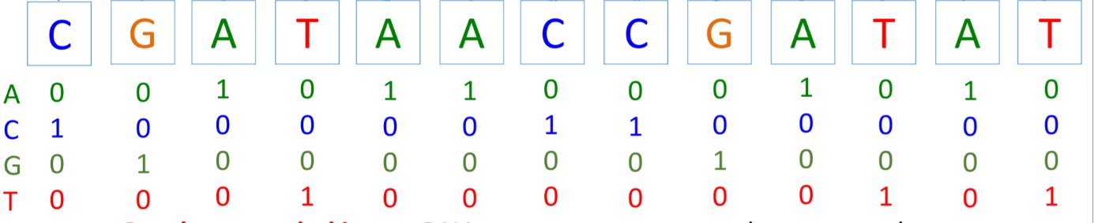
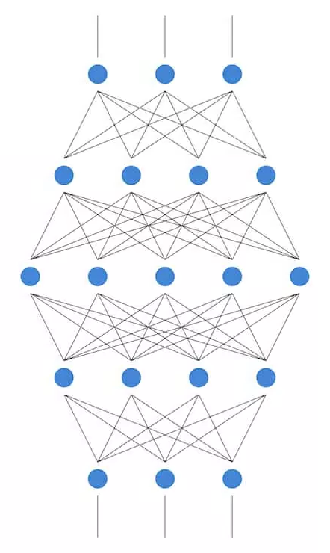
CNN (Sequence based) - Data
Input data
One hot encode A/C/G/T
Size 4 x 501
Output data
0/1 binary class
Size 1 x 1
C
N
N
Output: 0/1

Slide 22
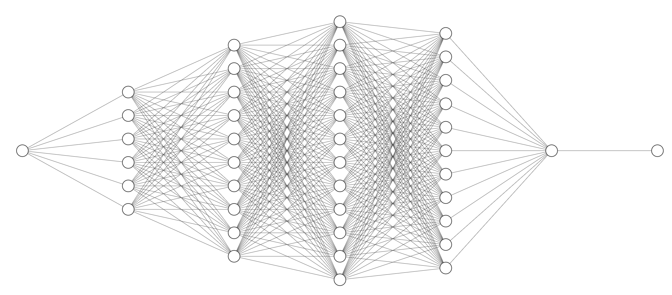
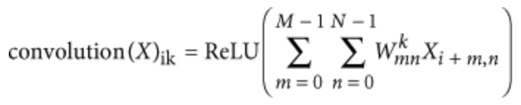
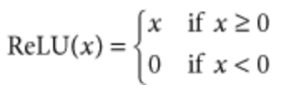


CNN (Sequence based) – Architecture
1. Convolution layer ( 320 kernels. Window size: 8. Step size: 1. )
2. Pooling layer ( Window size: 4. Step size: 4. )
3. Convolution layer ( 480 kernels. Window size: 8. Step size: 1. )
4. Pooling layer ( Window size: 4. Step size: 4. )
5. Convolution layer ( 960 kernels. Window size: 8. Step size: 1. )
6. Fully connected layer ( 925 neurons )
7. Sigmoid output layer
1 3 5 6 7
Convolution Convolution Convolution Fully connected Sigmoid

Slide 23
CNN (Sequence based) – Architecture (cont.)
Dropout proportion (proportion of outputs randomly set to 0):
Layer 2: 20%
Layer 4: 20%
Layer 5: 50%
All other layers: 0%
Loss Function: BCEWithLogitsLoss:
This loss combines a Sigmoid layer and the BCELoss in one single class
The equation as below, where N is the batch size

Slide 24
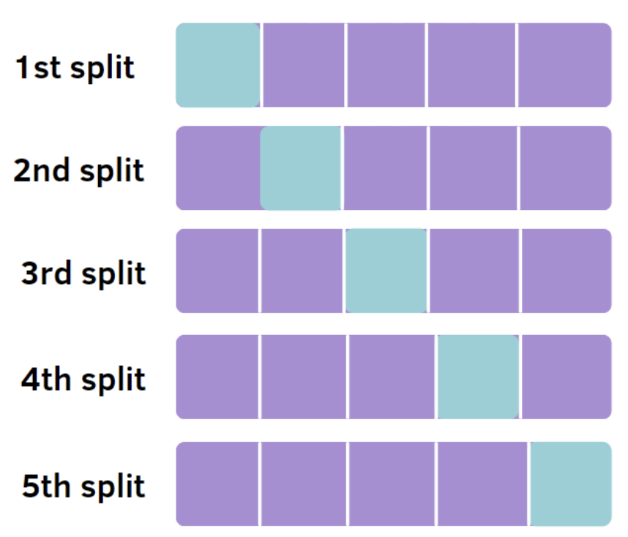
CNN (Sequence based) – K-Fold Cross-validation
The training set was randomly split to 5 part. 4 of them were used to train the model, and 1 one them was used to test.
The below parameters were used to test:
The number of epoch (5, 15, 30, 50)
Dropout proportion of layer 5 (0.1, 0.2, 0.3, 0.4, 0.5)

Slide 25
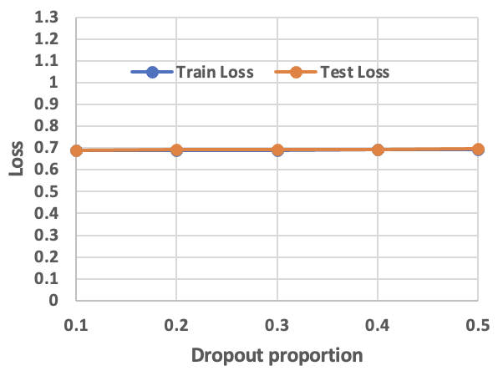
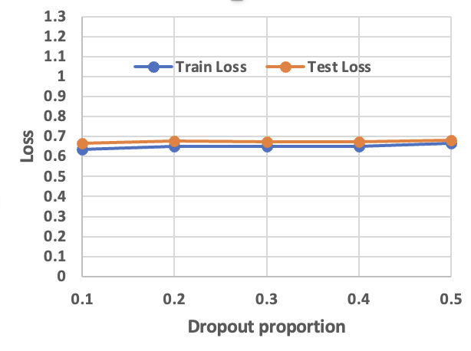
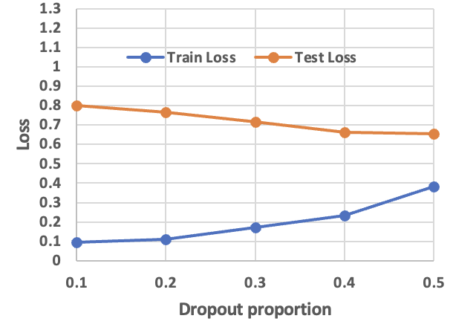
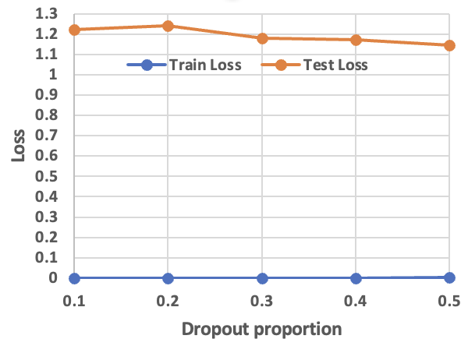
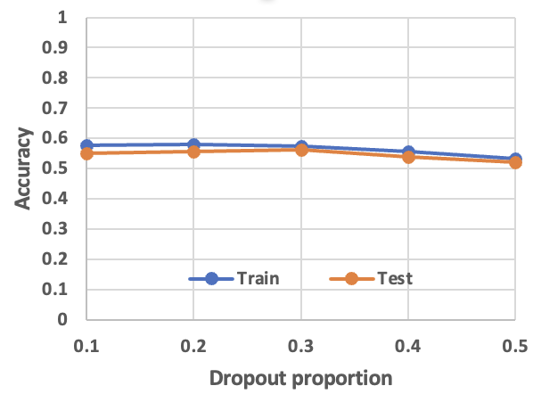
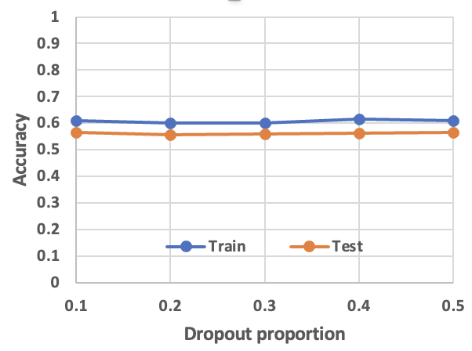
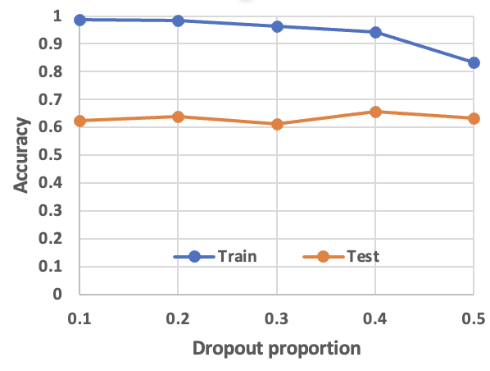
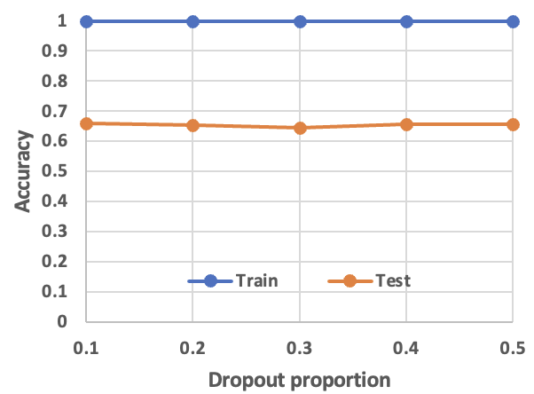
CNN (Sequence based) – K-Fold Cross-validation (cont.)
Epoch=5 Epoch=15 Epoch=30 Epoch=50
The CNN model was trained for 5 times under each condition (vary epoch and dropout proportion of layer 5) by randomly selected ⅘ BATF-train dataset by different epoch and dropout proportion, and left ⅕ dataset were acted as test data. The result is the mean value of these five times training. Blue represents the result of training data, and orange represents the result of testing data. For each epoch, we draw the Dropout proportion vs Loss and Dropout proportion vs Accuracy.

Slide 26
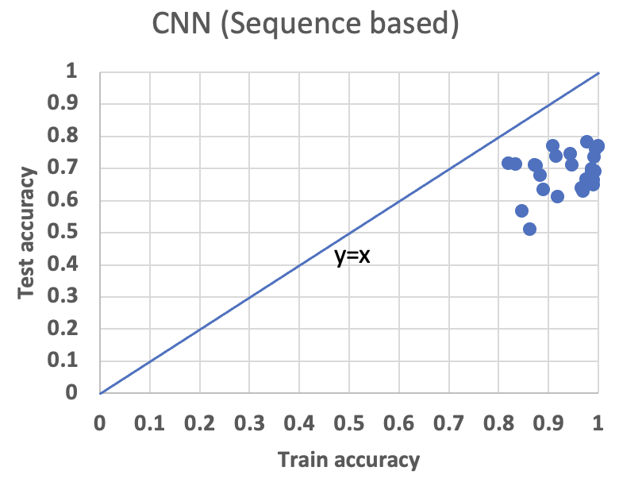
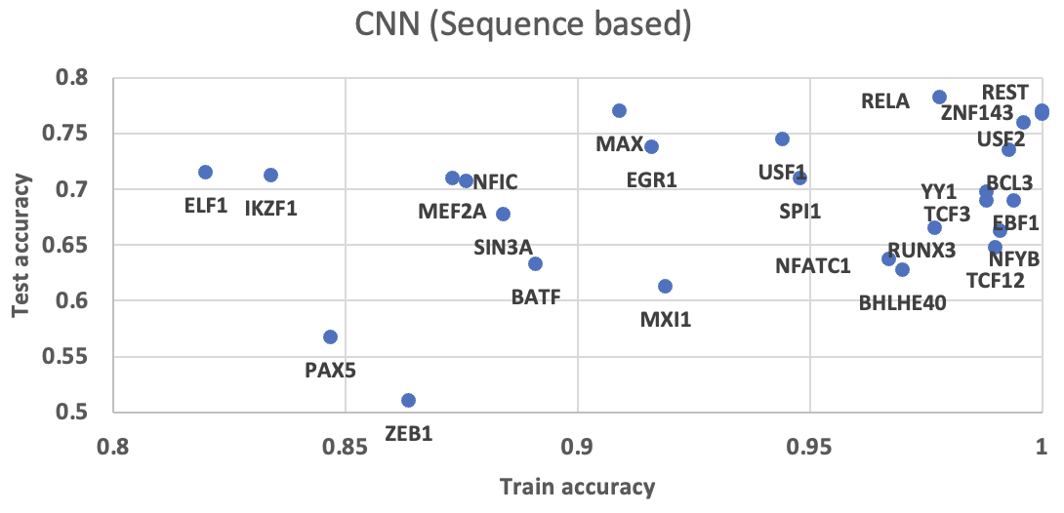
CNN (Sequence based) – Result
Train accuracy vs Test accuracy. The CNN (Sequence based) model was trained by 26 TFs separately. Each point represent train accuracy (x-axis) and test accuracy (y-axis). The average test accuracy is 0.69.

Slide 27
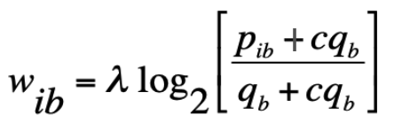
CNN (One PWM based) - Data processing
Include prior knowledge to improve the CNN model
[ 82., 43., 6., 369.],
[ 24., 86., 314., 76.],
[480., 2., 7., 11.],
[ 10., 178., 283., 29.],
[ 6., 7., 0., 487.],
[ 46., 440., 14., 0.],
[500., 0., 0., 0.],
[126., 12., 52., 310.],
[289., 36., 2., 173.],
[153., 93., 70., 184.],
[ 64., 236., 52., 148.],
[124., 56., 237., 83.],
[277., 37., 143., 43.],
[205., 34., 204., 57.],
[414., 51., 17., 18.],
[ 94., 170., 172., 64.],
[ 92., 138., 51., 219.]
[0.1640, 0.0860, 0.0120, 0.7380],
[0.0480, 0.1720, 0.6280, 0.1520],
[0.9600, 0.0040, 0.0140, 0.0220],
[0.0200, 0.3560, 0.5660, 0.0580],
[0.0120, 0.0140, 0.0000, 0.9740],
[0.0920, 0.8800, 0.0280, 0.0000],
[1.0000, 0.0000, 0.0000, 0.0000],
[0.2520, 0.0240, 0.1040, 0.6200],
[0.5780, 0.0720, 0.0040, 0.3460],
[0.3060, 0.1860, 0.1400, 0.3680],
[0.1280, 0.4720, 0.1040, 0.2960],
[0.2480, 0.1120, 0.4740, 0.1660],
[0.5540, 0.0740, 0.2860, 0.0860],
[0.4100, 0.0680, 0.4080, 0.1140],
[0.8280, 0.1020, 0.0340, 0.0360],
[0.1880, 0.3400, 0.3440, 0.1280],
[0.1840, 0.2760, 0.1020, 0.4380]
[0., 0., 1., 0.],
[0., 0., 1., 0.],
[0., 1., 0., 0.],
[0., 1., 0., 0.],
[0., 0., 0., 1.],
[0., 0., 0., 1.],
[0., 0., 0., 1.],
[1., 0., 0., 0.],
[0., 1., 0., 0.],
[1., 0., 0., 0.],
[0., 0., 1., 0.],
[0., 1., 0., 0.],
[1., 0., 0., 0.],
[0., 0., 1., 0.],
[1., 0., 0., 0.],
[1., 0., 0., 0.],
[0., 1., 0., 0.]
p_ib is the probability of base b at motif position i. q_b denotes the background probability of base b. We used q_b=0.25 for all four bases. lambda=1. c=0.0001, c is called the pseudo-count fraction and servers to prevent logarithm of zero
Input
1 x 485
Row PWM
Probability PWM
17 x 4
Sequence
501 x 4
Giovanna Ambrosini, Romain Groux, Philipp Bucher, PWMScan: a fast tool for scanning entire genomes with a position-specific weight matrix, Bioinformatics, Volume 34, Issue 14, 15 July 2018, Pages 2483–2484, https://doi.org/10.1093/bioinformatics/bty127

Slide 28
CNN (One PWM based) – Architecture
1. Convolution layer ( 320 kernels. Window size: 4 Step size: 1. )
2. Pooling layer ( Window size: 4. Step size: 4. )
3. Convolution layer ( 480 kernels. Window size: 8. Step size: 1. )
4. Pooling layer ( Window size: 4. Step size: 4. )
5. Convolution layer ( 960 kernels. Window size: 8. Step size: 1. )
6. Fully connected layer ( 925 neurons )
7. Sigmoid output layer
1 3 5 6 7
Convolution Convolution Convolution Fully connected Sigmoid

Slide 29
CNN (One PWM based) – Architecture (cont.)
Dropout proportion (proportion of outputs randomly set to 0):
Layer 2: 20%
Layer 4: 20%
Layer 5: 50%
All other layers: 0%
Loss Function: BCEWithLogitsLoss:
This loss combines a Sigmoid layer and the BCELoss in one single class
The equation as below, where N is the batch size

Slide 30
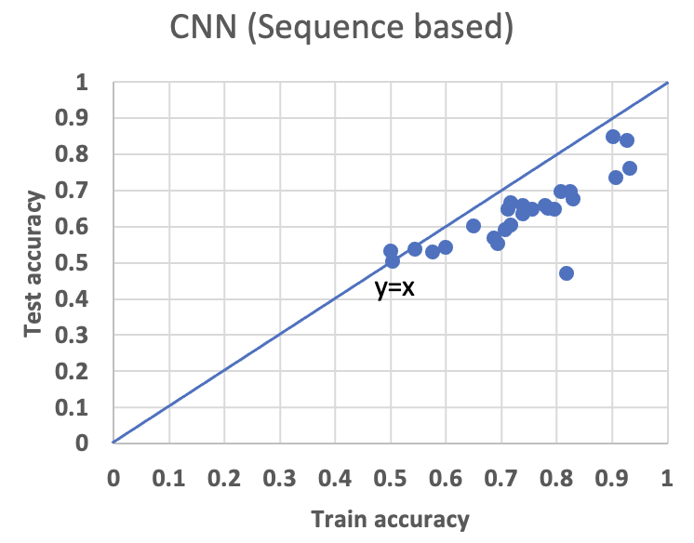
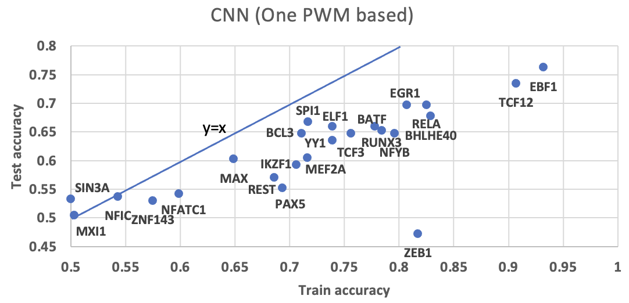
CNN (One PWM based) – Result
Train accuracy vs Test accuracy. The CNN (One PWM based) model was trained by 26 TFs separately. The PWM used was listed in supporting file. Each point represent train accuracy (x-axis) and test accuracy (y-axis). The average test accuracy is 0.63.

Slide 31
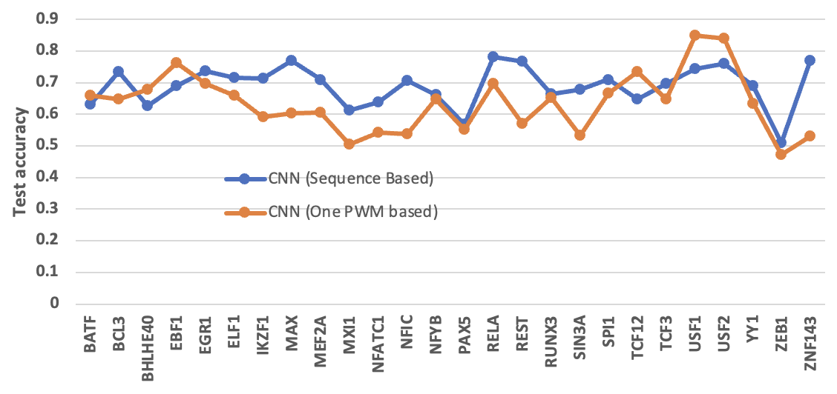
CNN One PWM based vs Sequence based Analysis
TFs vs Test accuracy. The CNN (One PWM based) model was trained by 26 TFs separately. X-axis represent the TFs name, and y-axis represent the test accuracy. Blue represent the result obtained by CNN (Sequence based), and orange represent the result obtained by CNN (One PWM based)

Slide 32
Discussion & Conclusion
Utilize PWMs to extract motif binding features has significantly improved the classification accuracy of both SVM and deep-learning model.
PWMs-aided SVM and deep learning methods can also be used for selecting the most significant PWMs, which might reveal biological insights.

